Slide 1




www.consultationskillsforpharmacy.com
Consultation skills: Meeting the new practice standards for pharmacy
Notes:
Before you start the workshop
Warm up activity to run as participants are arriving or getting refreshments
Warm up: Developing your skills and behaviours
Before coming to the workshop, participants were asked to look at the new practice standards for consultation skills (included in pre-workshop book).
Put up two posters: both titled ‘Key features from the practice standards’. Add to one of the posters a further title:
‘I do this already and think I achieve it and do it well’.
Add to the second poster:
‘I’m not sure I do this, it could be a challenge…’
Ask participants to write one post-it note for each poster; you will refer back to this during the presentation (slide 17)
Welcome and introduction from the facilitator
Housekeeping – phones, toilets and fire
Ground rules – Print out copies of the suggested ground rules provided in Appendix 1 of the Facilitator’s guide. Ask participants if anyone wishes to add to them or make other suggestions.
Key point to mention to participants: We will be doing a short role play activity. Don’t worry about getting things wrong today – this is how we learn and improve our skills.

Slide 2
Aim
To enable pharmacy professionals to work towards and demonstrate the new practice standards, to support reflection on practice, and development of effective patient-centred consultations, using the Consultation skills for pharmacy practice learning and development programme.
Notes:
New practice standards for consultation skills have been developed which are the key skills and behaviours (competencies) that all pharmacy professionals (pharmacists and registered pharmacy technicians) should aspire to in their practice.
Explain to participants that the workshop provides an opportunity for them to start reflecting on their current skills and thinking about their next steps in developing a more effective, patient-centred approach, to the consultations they conduct. There may be participants who already apply a patient-centred approach to their consultation and the reflective process provides reassurance that their practice is effective. It also acts as an introductory taster session for the one-day consultation skills workshop.

Slide 3
Learning outcomes
Recognise your professional responsibility to reflect on and develop your consultation skills, by working towards the new practice standards
Explain the concept of patient-centred care and identify methods of integrating this into your practice
Apply a reflective tool to assess your ability to consult effectively with patients and identify key areas on which to build your expertise
Access tools and resources from the Consultation skills for pharmacy practice programme to support you in moving your practice forward
Take your current skills on a ‘test drive’ by taking part in role play scenarios with pharmacy colleagues in a safe environment
Notes:
These are taken from the pre-workshop book so there should be no need to read them through. Just give participants a minute to remind themselves of them.

Slide 4
How do we communicate?
Words
Tone of voice
Body language Facial expression
7% ?
55% ?
38% ?
Notes:
Ice breaker – see Facilitator’s guide for detail
This ice-breaker refers to Mehrabian’s theory of communication. The aim of the ice-breaker is to emphasise the fact that the main way in which we communicate our emotions and feelings is via body language and in particular facial expression. The theory is referred to in Task 1 of the pre-workshop book, so will test the memory of participants.
Before the event – Add a post-it note to each workshop book and divide the workbooks into three piles. Write ‘words’ on one set of post-it notes, ‘tone of voice’ on the second set of post-its and ‘body language (facial)’ on the third set.
Then prepare three A4 posters : Poster 1 – 7% Poster 2- 38% Poster 3 – 55%. Spread the posters around the room.
Ice breaker: Mehrabian’s theory states we use three methods to communicate our feelings and attitudes: words, tone of voice and facial expression, but not all of these are equally powerful in communicating those feeling and attitudes.
Ask participants to look at the post-it note on their workshop book. Ask them:
How much of the meaning of a message (ie. feelings and emotions) is communicated by the method you have written on your post-it? You can see three posters round the room with percentages on – move to the poster which represents your method of communication. This will have been something you covered in one of your pre-workshop tasks, but if you don’t remember then chat to others near the poster to see if your answers correlate.
Move to the next slide to see the right answers.

Slide 5
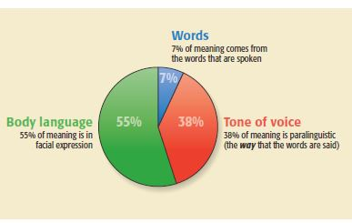
How do we communicate?
You can speak volumes without uttering a single word!
Notes:
This is the correct answer. Point out that they can see how important their facial expression is when speaking with patients. ‘You can speak volumes without uttering a single word!’
Spilt your group initially into groups of six, depending on numbers. You will need to do a further split into 3s when it comes to the role play session.

Slide 6
What is a consultation?
‘A meeting to discuss something or get advice, with the goal of discovering the best course of action to take’
Medicines reconciliation/medicines optimisation
Hospital bedside
Handing out discharge medicines/prescriptions
OTC requests
Public health discussions (weight management, smoking cessation)
Every time you speak with a patient you have the opportunity to make a difference
Notes:
Explain to participants:
Before we start it may be useful just to clarify what we mean by the term ‘effective patient-centred consultation’.
What do we mean by ‘consultation’? You might think it only refers to consultations that happen in the consultation room or at the hospital bedside. But we consider a consultation to be every interaction you have with a patient. Every time you speak with a patient you have the opportunity to make a difference.

Slide 7
What does the patient-centred consultation look like?
?
?
?
?
Notes:
Do you think you achieve a patient-centred approach in your consultations?
(Slides 9-11 challenge participants to think about this…)

Slide 8
The patient-centred consultation
True partner:
Shared discussion, shared decision making
Give options
(rather than recommendations)
Listen
(rather than telling)
Respect and value
(their beliefs, knowledge and concerns)
‘Patient-centred care is care that meets and responds to patient’s wants, needs and preferences and where patients are autonomous and able to decide for themselves’
Notes:
Explain to participants:
Achieving the patient-centred approach isn’t straightforward. It takes practice and patience’ Time is a challenge in the consultation but by applying new consultation skills and models to your consultation you can ensure that both you and the patient get the most from the discussion. You can see some of the key areas of patient-centred care here –
True partner- treating the patient as a true partner right from the start involving them in the discussion and the decision making process
Provide options and balancing the risks and benefits of those options to enable the shared-decision making process
Sometimes we might be too keen to revert to telling mode and give the patients a lot of information rather than establishing what they already know and believe about medicines
Respecting the beliefs and values of the patient

Slide 9
The challenges to you…!
Is your approach patient-centred?
What are your perceptions of your own skills?
Notes:
……..Maybe you do this already?
Let’s take a look at the challenges!

Slide 10
Challenge …what is your current practice?
Practitioner-centred practice
‘My role is to give advice… I sometimes don’t have enough time to tell them everything about their medicine’
‘I like to give advice, after all I am the expert’
‘What do I want to achieve from this consultation?’
Patient-centred practice
What does the patient already know or would like to know?
The pharmacy professional and the patient are equal experts
Negotiate a shared agenda with the patient
Notes:
Challenge your participants:
What is your current practice like? Practitioner-centred or Patient-centred?
It may already have elements of a patient-centred approach or does some of it look like the first column?
Give participants a moment to read the slide then just cover the points quickly
Telling: We know lots of stuff and are sometimes too eager to jump into an advice-giving role without establishing what the patient knows already or would like to know. If we do this a patient may feel patronised and resist or reject the advice we give and feel their competence to self-manage has been questioned.
Who’s the expert? The pharmacy professional may be an expert in medicines/health, but the patient is an expert in themselves, their social circumstances, psychological and other factors which may affect their health behaviours.
Agenda – you may think your agenda is the priority but if the patient has something else on their mind they may not be able to address your agenda until they have addressed their own.

Slide 11
Challenge …what is your current practice?
Practitioner-centred practice
‘I do most of the talking …that’s how it should be!’
‘I make the decisions and recommendations in the consultations so the patient knows they will get the best outcome if they follow them’
Patient-centred practice
Listen to the patient to get their perspective…what are their beliefs, concerns and expectations? “tell me what you know about your medicines”
Shared decision making and offering options to encourage ownership and responsibility
Notes:
Tell participants to think about these points in the role play session:
What’s the first thing you do when you speak with a patient?
Are you too eager to give information?

Slide 12
Some perceptions…?
I’m naturally good at this, I talk to patients every day
Once I’ve been trained, that’s it
A ‘good’ consultation is about being nice, professional, structured and making sure the patient knows what to do and is more educated at the end
OTC encounters are not consultations
The performance of my team and colleagues is up to them, I’ll help if I can
I can’t get any better…I am what I am…!
Consultation skills are a learned skill
Notes:
Ask participants what their perceptions of their own skills are?? Let them read the slide and suggest:
Take a look…are any of them your perceptions? We hope some of them aren’t but there can be a misconception that this is just talking to patients and there is no skill or technique involved when we know that there is robust evidence which states that Consultation skills are a learned skill.
Explain that:
All of these things have led to the development of the Consultation skills for pharmacy practice programme which we’ll talk about now

Slide 13



Consultation skills for pharmacy practice
Developing skills identified as a priority by HEE, to support medicines optimisation and public health agenda – new practice standards
Pharmacy is changing, the role is constantly evolving: Now or never!
Wide range of skill set throughout the profession
Responsibility to put the patient at the centre of their own care
Notes:
This slide represents the background to the programme and why it has been developed.
The Consultation skills for pharmacy practice initiative has been developed by HEE in partnership with the Centre for Pharmacy Postgraduate Education and is supported by the Royal Pharmaceutical Society and the Association of Pharmacy Technicians, UK.
Pharmacy professionals (both pharmacists and pharmacy technicians) in most sectors have a more prominent patient-facing role. There is a wide range of skills in the profession, ranging from newly registered pharmacists who have done formal learning on consultation skills but have little patient experience, through to pharmacists/pharmacy technicians who have experience but no history of formal training for consultation skills.
HEE identified the need to develop the consultation skills of the profession as a priority within both the medicines optimisation and public health agenda.
A new set of national practice standards for pharmacy professionals have been developed and in order to support the profession in working towards these standards, a new national learning and development programme has been developed to support you in working towards these standards.

Slide 14
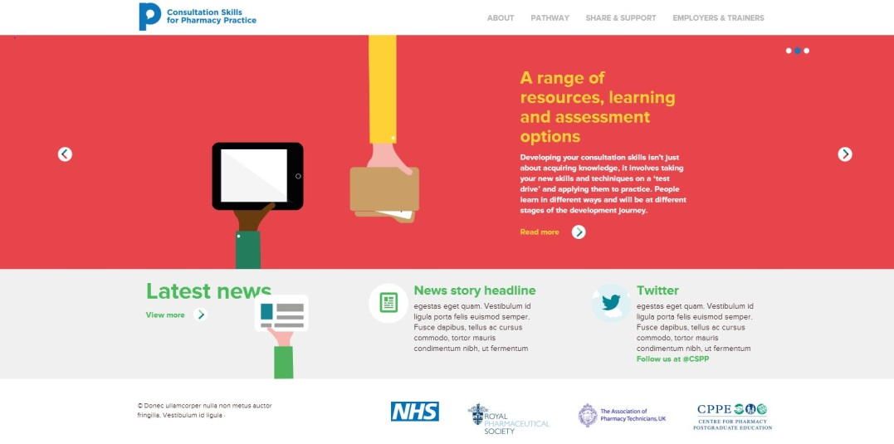
www.consultationskillsforpharmacy.com
New six-step pathway developed
Notes:
Explain to participants:
The six-step learning and development pathway has been developed to support you in reflecting on your current skills, learning new ones and assessing your knowledge of consultation skills and behaviours. The programme has its own website – this is the homepage.

Slide 15
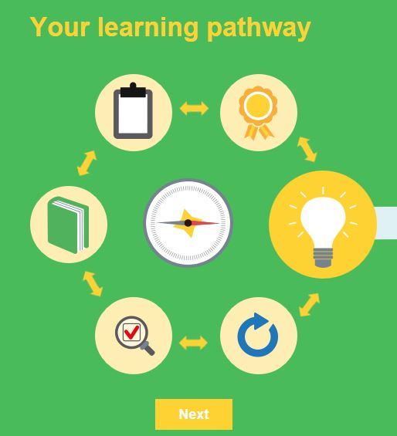
Six-step model to improvement
Why?
What standard?
Where am I?
How do I improve?
Check my learning?
Ongoing improvement?
Notes:
Explain to participants:
We’ll take a whistle-stop tour through the learning pathway to outline the tools and resources available to you
(this really is a quick tour as participants can access the website individually to take a closer look). They may have accessed it during whilst working through the pre-workshop booklet.
This is how the learning and development pathway appears with each step represented by an icon

Slide 16
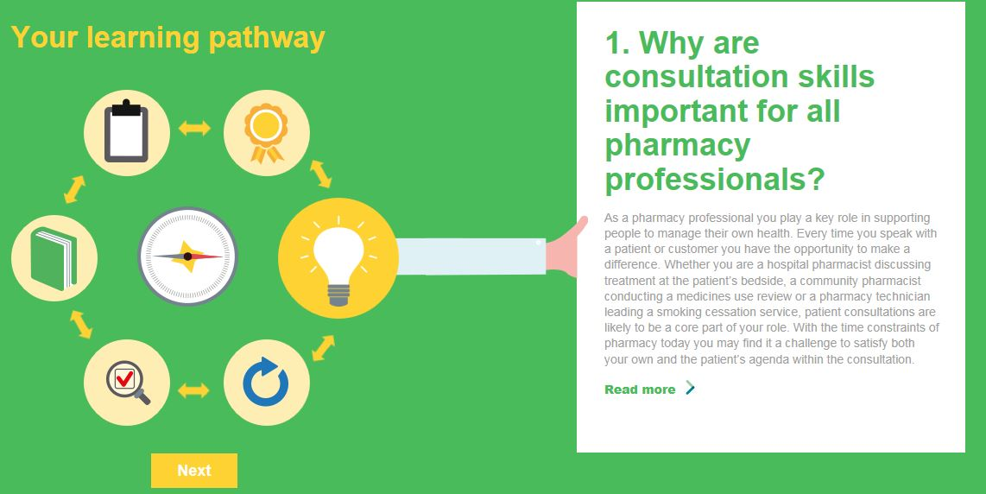
The six-step pathway
The pharmacy profession is integrated into the NHS and committed to patient-centred care
The literature suggests that skills in taking a patient-centred approach are demonstrated poorly
Notes:
Explain to participants:
This is how the learning pathway appears on the website. You can see there are six icons (light bulb, rosette, clipboard, book, magnifying glass and CPD cycle). Each one represents a learning and development step for you. The light bulb is the ‘why’ – we’ve already mentioned the main reasons why consultation skills are important to the profession.
(the text in bold on this slide is worth mentioning here (ref Greenhill et al.))
Step 2 contains the national practice standards (detailed on the next slide).

Slide 17

2. How do I know what standard is expected of me?
The national practice standards for pharmacy professionals:
Provide a framework of standards for consultation skills expected of you as a pharmacy professional
Outline the key knowledge, skills and behaviours in detail
How will you work towards the standards?
Notes:
The national practice standards for pharmacy consultations have been developed to provide a framework of the key knowledge, skills and behaviours expected of a pharmacy professional when speaking with patients. Participants will have seen a set of the practice standards, included in Appendix 1 of their pre-workshop book.
The key point from the slide to make to participants:
As a pharmacy professional you are expected to work towards and demonstrate these standards
These include core skills, such as active listening and applying appropriate questioning techniques in the consultation, as well as broader skills, such as considering a patient’s ideas, concerns and expectations of the consultation. Challenge for them is how will they work towards these standards?

Slide 18
The practice standards – your thoughts…
In the pre-workshop task you looked at the new practice standards
Which of the key standards did you identify with as your current practice
Which of the key standards might present a challenge to your practice?
Notes:
Tutor please take a look at the posters from the warm up at the start of the workshop.
Highlight the main standards that people think they already achieve and then address some of the challenges (spend about three minutes). Hopefully, as participants develop practice, there will be more on the ‘I already achieve this’ side.

Slide 19

3. How do I know how effective my skills are now?
Reflection, feedback, reflection, feedback ...
Reflective tool (MRCF)
Patient feedback questionnaires
Peer review
Video critique
Notes:
Explain to participants:
The next step of the pathway focuses on self-assessment of current skills and behaviours. We’ve already talked about perceptions and this is something you may think you do well……and you may! But how do you really know?
Reflection on your practice is key to development. There are a range of resources available via the website which you can access. These include the MRCF, which you used in the pre-workshop task, patient questionnaires and guidance on peer review and video critique, which we are going to do now as an activity.

Slide 20
Activity 1- Video critique
Use the consultation skills observation form
Look for the positive elements of each consultation and any areas for development
Feed back on the specific skills your group has been asked to observe
Questioning
and
explaining
Taking a patient-centred approach
Closing
Welcoming
Building relationships
Notes:
This is a chance for participants to look at a video consultation and critique it (allow a minute or so for them to become familiar with the form).
Explain to participants:
The following video shows a new medicine consultation. Working through the critique with colleagues will help share ideas and thoughts about the consultation. There is no such thing as a perfect consultation; everyone will bring their own style and personality to a consultation. Bear this in mind as you watch. If you are a hospital pharmacist or a pharmacy technician who does not conduct the NMS consultation then the video is still relevant. Overall, we should demonstrate the same skills and behaviours to be effective.
Keep to groups of six and allocate each group one or two sections of the observation form to concentrate on (as slide).
Ask participants to:
Work in groups to critique the sections you have been allocated for the consultation, using the video consultation observation form in the workshop book, and then give constructive feedback to the room.
Allow participants a minute to read their section of the form.
Appendix 2 from the Facilitator’s guide provides the key points to raise following group feedback.

Slide 21
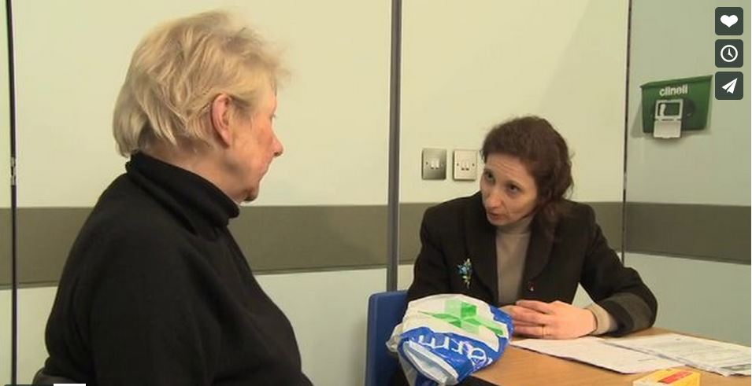
Video critique
A pharmacist conducts a NMS consultation with a patient who has recently been diagnosed with a stroke
Notes:
The video runs for about five minutes. You can either access this from the hyperlink in the presentation (this will only work when the PowerPoint is in full slide mode) or via the link in your Facilitator’s guide We strongly recommend you download it to your laptop by accessing the video file in the materials list.
Once the video is finished allow the groups about five minutes to discuss their section of the critique. Encourage them to consider other elements on the form too.
Take two points of feedback from each group (1: what went well 2: what they would do differently) (8 minutes)
Remind participants that they can assess their own consultation skills by videoing them and then critiquing them afterwards (but take care to get consent from all involved)
At the end of the session you will return to the six-step pathway.

Slide 22

4.How do I improve my performance?
Learning resources
CPPE distance learning programme
CPPE e-learning
CPPE video wall
CPPE face-to-face learning
Notes:
This section of the pathway provides you with a set of core learning resources and signposting to additional learning you may wish to access as you continue to develop your practice. You will have received the distance learning programme on consultation skills in the post (to be delivered to all registered pharmacy professionals in March 2014) and this has been developed as one of the core learning resources along with this workshop (cover shown on next slide). There is also a CPPE e-learning programme on consultation skills and a video wall of NMS consultations which will help your observation of practice. This area of the CSfPP will continue to grow with the addition of new programmes on consulting with children, older people, people with mental health issues and dementia.

Slide 23
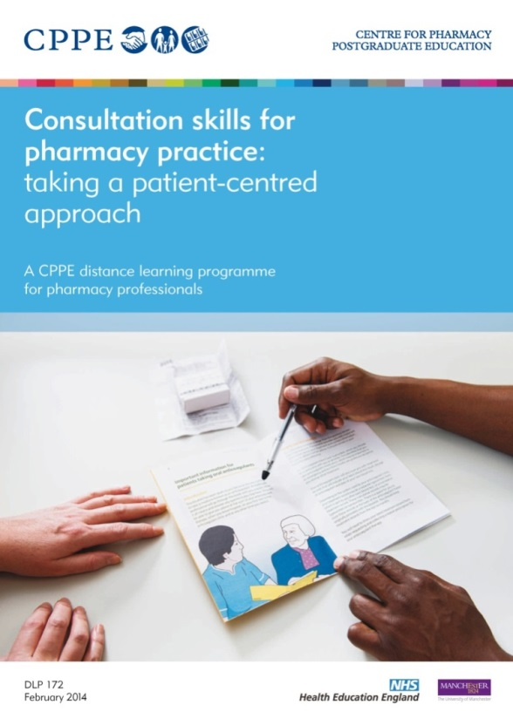
Distance learning programme
Notes:
This is the key learning resource which you can also download from this area. Now going to do some role plays as a taster for the one day session

Slide 24
Activity 2- Role play consultations
Opportunity to practice in a safe and supportive environment (it’s OK to get things wrong)
Consultation skills matter, don’t get tied up in the clinical stuff!
Think about a patient-centred approach
You don’t need to complete the whole consultation (you may get specific sections to cover in the brief)
Stick to time – no longer than five minutes on the actual role play
Notes:
Explain to participants:
The role plays are not complicated – don’t get tied up in clinical issues – the focus is on how you communicate with patients. Think about some of the key points around patient-centred care (leave slide 25 up as they do the role play)
Work in groups of three to ensure everyone has a go at each role, with one person taking the role of the ‘pharmacy professional’, the second as the ‘patient’ and the third member of the group taking constructive notes as the observer. Ask the observer to complete the spare observation form in the workshop booklet belonging to the person playing the pharmacy professional. Also ask the observer to keep time for the group.
If you have a large group and space is tight you may need to use larger groups, but this means some people will not get an opportunity to role play (see next slide)
Allow 15 minutes for each role play – two minutes to read the brief, five minutes maximum for the role play and eight minutes for debriefing (this is where most of the learning occurs). They should be encouraged to use mobile devices to video if everyone in the group is OK with this. Run through Pendleton’s rules of feedback on the next page first to make sure everyone gives appropriate feedback.
Warn them that they may not get a full consultation to role play (and they shouldn’t rush to complete it)

Slide 25
Group feedback information: Pendleton
Stick to the Pendleton feedback rules.
  What went well (for pharmacy professional, then the patient, lastly the observer)
  What could have been done differently to improve the consultation (for pharmacy professional, then the patient, lastly the observer)
Notes:
Role plays have been developed in a separate document for the event. Make sure you have copies to share around. Separate the pharmacy professionals brief from the patient brief beforehand
Pendletons feedback rules: emphasise that it is important to concentrate on the positives of what went well in the consultation first of all and go round the group of 3 as on the slide; pharmacy professional first then patient then observer before moving on to what could have been done differently.
Encourage the group to use their mobile devices to video themselves in action if everyone in the group agrees to this. Leave the next slide up as they work through the role plays.

Slide 26
Patient-centred approaches to try out in your role play…
Establish what the patient would like to get from the consultation...’We’ve invited you today for a medicines use review, is there anything else you’d like to chat about while you’re here?’
Establish what the patient already knows about their medicine or condition (open questions); ‘Tell me what you know about your …’
Listen to the patient, establish any beliefs or concerns and respond without judgement ‘Do you have any worries or concerns about your medicines?’
Discuss options and include the risks versus benefits of those options
Encourage the patient to take ownership and responsibility of the plan ‘Which of these things do you think would work best for you?’ ‘We’ve covered quite a lot today, tell me what you’re going to do when you get home…’
Notes:
Here are some key points the participants can think about during the role play. At the end of the role play you can continue on to the last two steps of the pathway...

Slide 27

5. How can I check my learning and development?
Assessment is hosted on CPPE website
Aim: to assess your identification of key skills and behaviours and good practice, versus practice that could be improved.
Four sections
MCQ questions
Identify the key skills demonstrated
Rate the practice demonstrated
Identify the key skills demonstrated and rate those present
Notes:
Explain to participants:
There is a formal assessment linked to the learning and development pathway. At the moment this is not mandatory. However, assessment is a key part of the learning process and provides you, other healthcare professionals and patients, reassurance that you are working towards improving practice. When you access this area of the Consultationskillsforpharmacy.com website you will be directed to the CPPE website where you will be asked to log in.
There are four sections to the assessment (see outline on slide). Section 1 is a MCQ section (similar to other CPPE assessments). After that sections 2,3 and 4 involve observation of videos and identification and rating of key skills and behaviours demonstrated in the video.
We have taken a very different approach in designing this assessment – here is an example of a screenshot from section 2 of the assessment just to give an idea of how it appears. This design continues throughout the assessment.

Slide 28
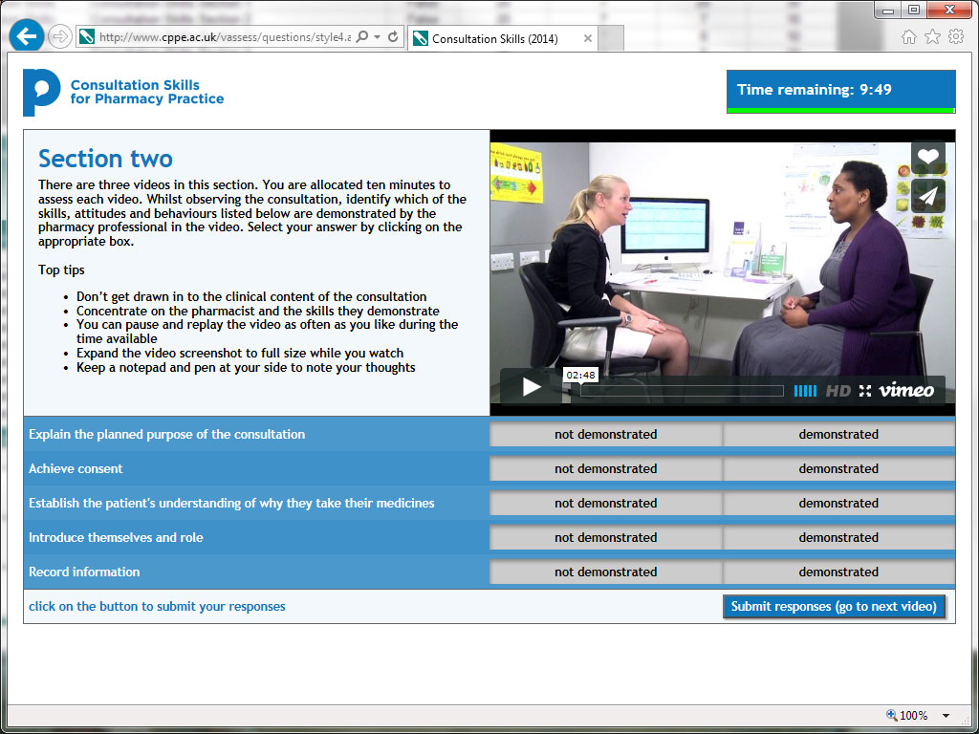
Notes:
Explain to participants:
This is just an example of how the assessment screen looks. It provides an explanation of what you need to do in this section with the video to be assessed embedded in the screen (this is just a quick preview so you are prepared for the set up once you take the assessment)

Slide 29

6. How do I continue to develop my performance?
You can always improve!
Bad habits soon creep into practice without taking time to reflect
Every consultation and every patient/customer is different
How can you adapt your skills?
Notes:
Explain to participants:
Learning effective consultation skills and behaviours is not a one-stop shop. It can take years of practice to refine your consultations and adapt your skills to the different types of consultations and patients you meet in daily practice.

Slide 30
Activity 3- patient questionnaires
In your groups have a quick discussion about your experiences of using the patient questionnaire tools
Was patient feedback useful?
Did you learn anything new about yourself using this method of feedback?
How will this shape your future practice?
How will you integrate these tools into your practice?
Notes:
In the pre-workshop task, participants were asked to use the patient questionnaires in their practice. This activity is designed to get the groups to reflect on their experiences of using the questionnaires Allow about five minutes for the activity. Take one point of feedback per group if time allows. You may find that the group didn’t complete this activity. If this is the case then you will need to adapt the activity by asking them to discuss the challenges of receiving patient feedback. What were the barriers and how can they move forward with this. Would peer review be a good first step before patient feedback?

Slide 31
Next steps: Be brave …step outside the box!
Peer review
Patient feedback
Observation of colleagues and other healthcare professionals in practice
Revisit the medication-related consultation framework (MRCF)
Attend a one day face-face session to build up your practice
Visit the website www.consultationskillsforpharmacy.com
Notes:
Explain to participants:
Here are some of the things you could do next as part of your ongoing development (Step 6 of the learning pathway)
The one-day workshop takes your learning a step further by addressing the models and tools you can apply to your practice. You will be encouraged to road test these with medical role player actors playing the role of your ‘real’ patients.
What will you commit to ….write two points in your workbook.

Slide 32
Take home messages
Commit to making a change to your practice
You can keep learning, you can get better
There is no such thing as the perfect consultation, but you can demonstrate good practice
Listen to the patient (and perhaps try to do less ‘telling’?)
Take a holistic view of the patient thinking about all the other issues which may influence their personal decisions around health and medicines
Notes:
Commit to making a change- however small or big

Slide 33
Close
Don’t forget your next CPPE events
To be completed by facilitator…………………………………..
Thank you and safe journey home

Slide 34




www.cppe.ac.uk
info@cppe.ac.uk
0161 778 4000
        Follow us on Twitter, Facebook, LinkedIn and YouTube:
          www.twitter.com/cppeengland
          www.facebook.com/cppeengland
          www.linkedin.com/company/centre-for-pharmacy-postgraduate-education
          www.cppe.ac.uk/youtube

